Slide 1
SAP EWM EXTENDED WAREHOUSE MANAGEMENT TRAINING
AnubhavTrainings.com
www.anubhavtrainings.com

Slide 2

SAP EWM TRAINING
BY:-
Mr. Bijoy
www.anubhavtrainings.com
Notes:
https://unsplash.com/photos/uXB-7la5vqA

Slide 3
SAP EWM TRAINING (Day 09)
AnubhavTrainings.com

Slide 4
Internal Processes & Work center
Internal Processes & Work center
Internal Processes - Product WT, HU WT for Adhoc movements, Posting changes
Work Center configurations
WT creation using Warehouse monitor

Slide 5
Wave Management
We can use Wave Management to combine items or split items from warehouse requests for outbound deliveries into waves. These waves must be picked and processed at roughly the same time.
Output of wave release is Creation of Warehouse task.
Check SAP EWM Help portal for more details.

Slide 6
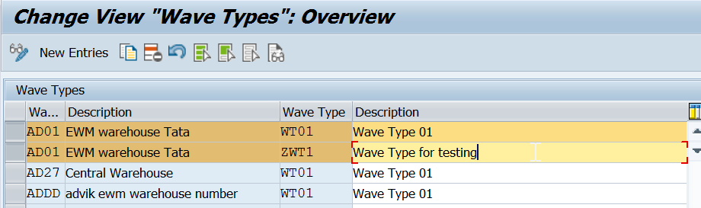
Maintain Wave Types
Determines the wave type with respect to specific properties or a specific behavior, and thus allows a specific consideration in the warehouse management monitor.

Slide 7
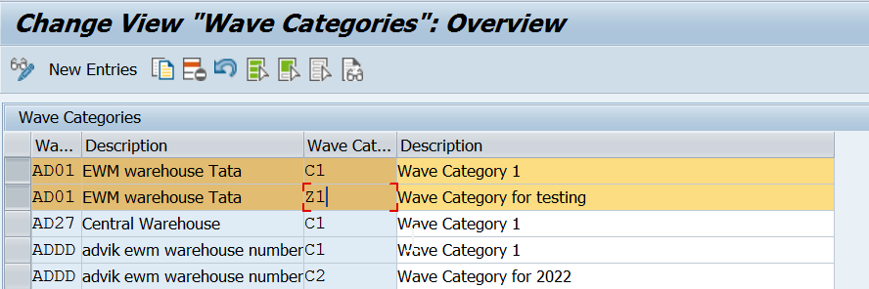
Maintain Wave Categories
Defines the wave type that you can use as a filter value for the warehouse order creation rule.

Slide 8
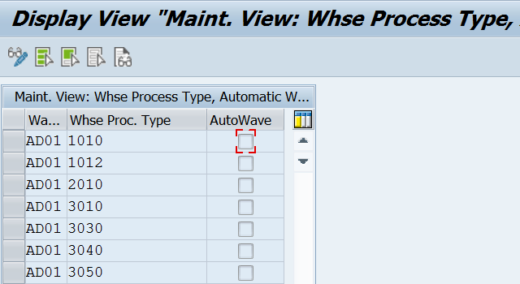
Set Automatic Wave Generation For Whpt (For Auto Wave Generation Only)
In this IMG activity, you determine for which warehouse process types you want waves to be generated automatically.
If you set this indicator for a warehouse process type, then during the creation of a warehouse request (WR) of this warehouse process type, one of the following will occur, based on the condition technique for wave template determination:
One or more waves will be automatically created for the WR
One or more WR items will be assigned to an existing wave(s)

Slide 9
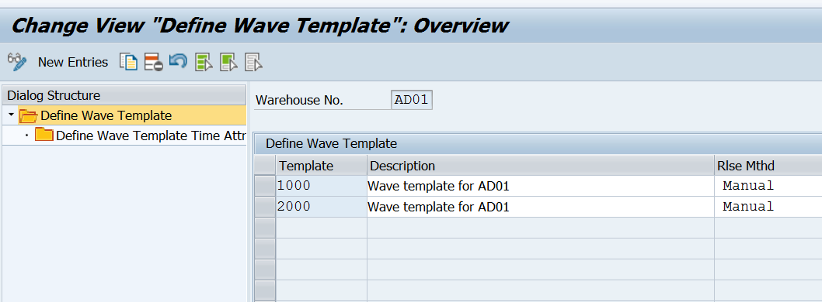
In case of Automatic Wave release, Wave release will happen based on Wave template Master data > Define wave template time attribute.
Maintain Wave Template Master data by Tcode - /scwm/wavetmp

Slide 10
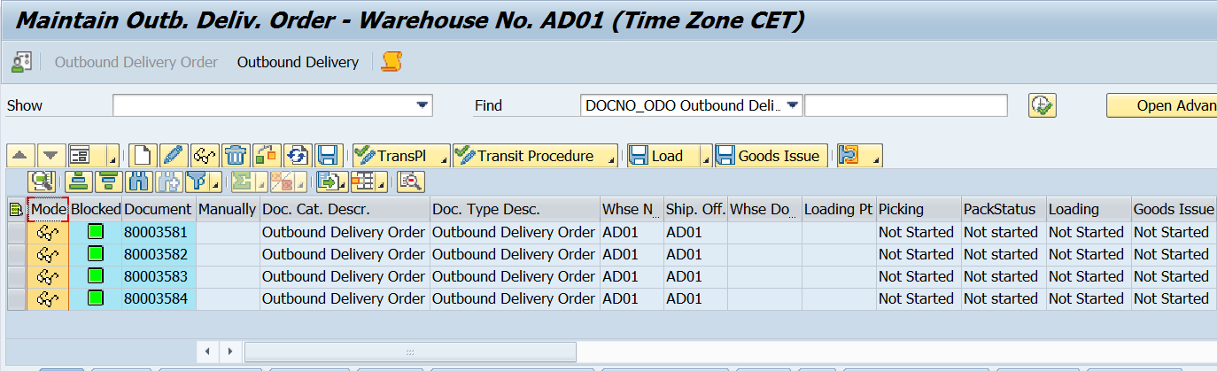
Test Scenario
Create multiple OBDs with diff quantities for the same Material.
Go to Tcode - /scwm/wave
Create Wave

Slide 11
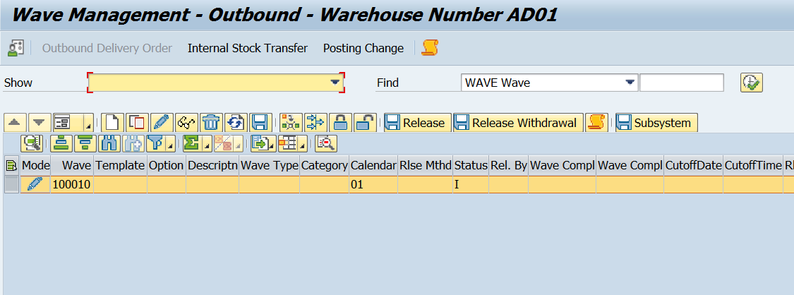
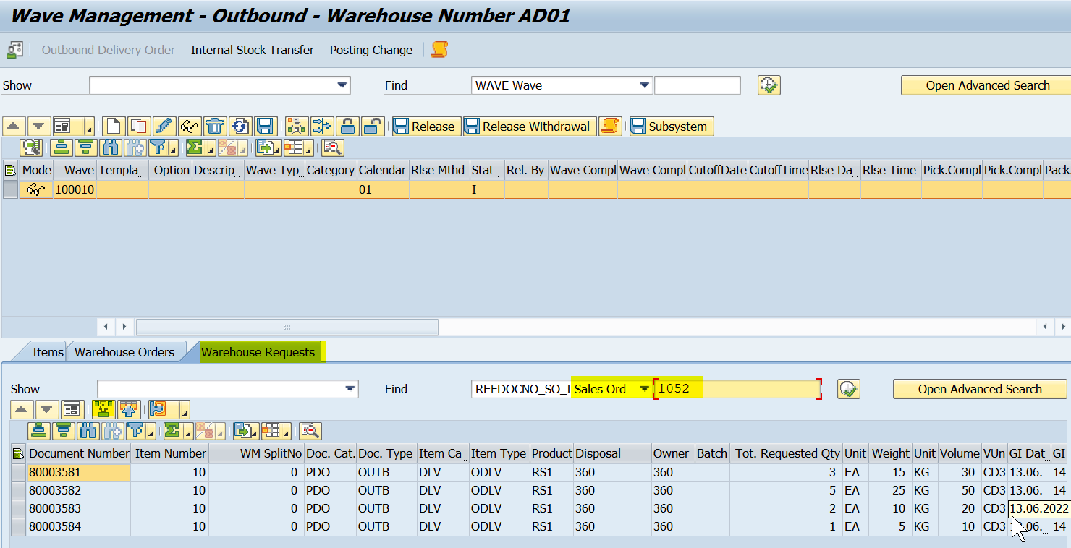

Slide 12
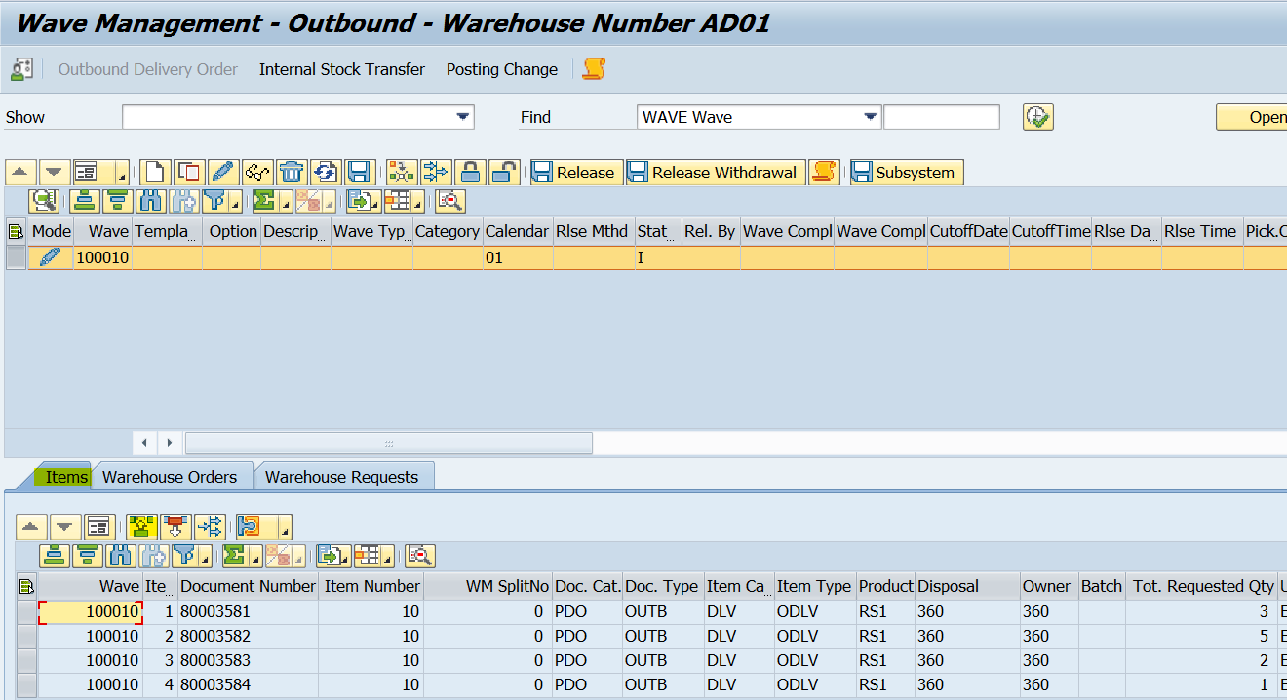
Assign OBDs to Wave
www.anubhavtrainings.com

Slide 13
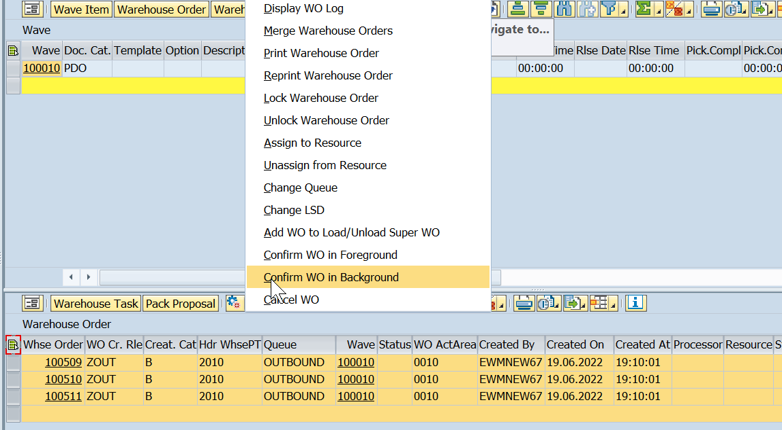
Note - Output of wave release is Creation of Warehouse task.
Go to Warehouse monitor - /scwm/mon
Select all Warehouse Orders and Confirm.
www.anubhavtrainings.com

Slide 14
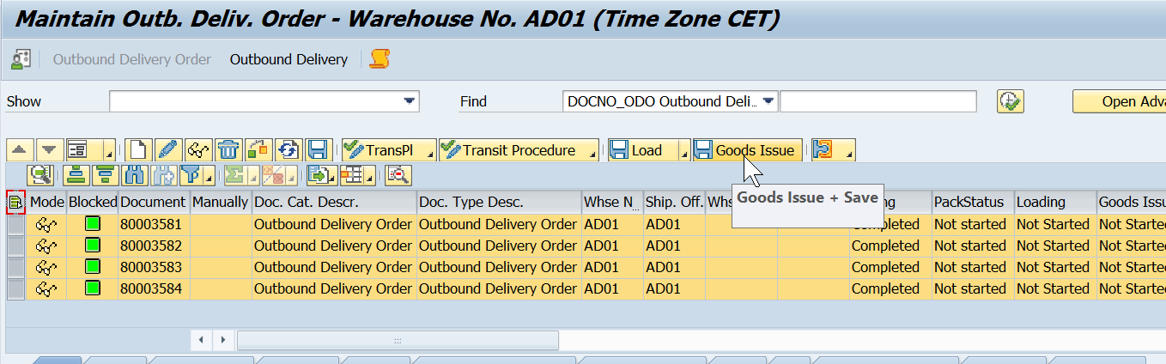
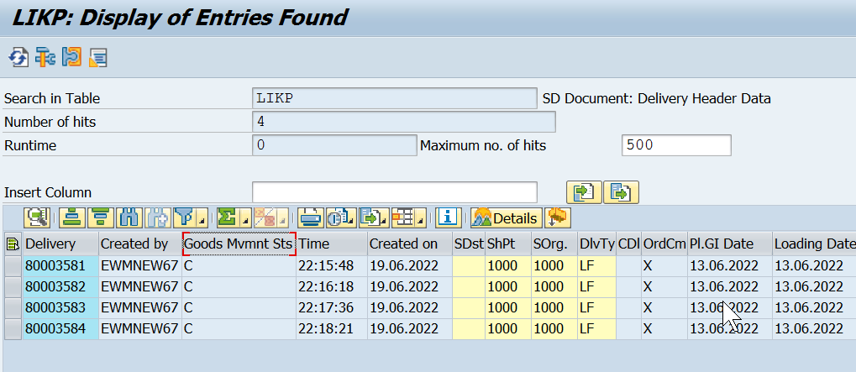
Select all Warehouse Orders and Confirm.
Go to /scwm/prdo and Goods issue.

Slide 15


End of Session 09
www.anubhavtrainings.com

Slide 16

FEEL FREE TO ASK QUESTIONS

Slide 17

Feedback

Slide 18
THANK
YOU

Slide 19

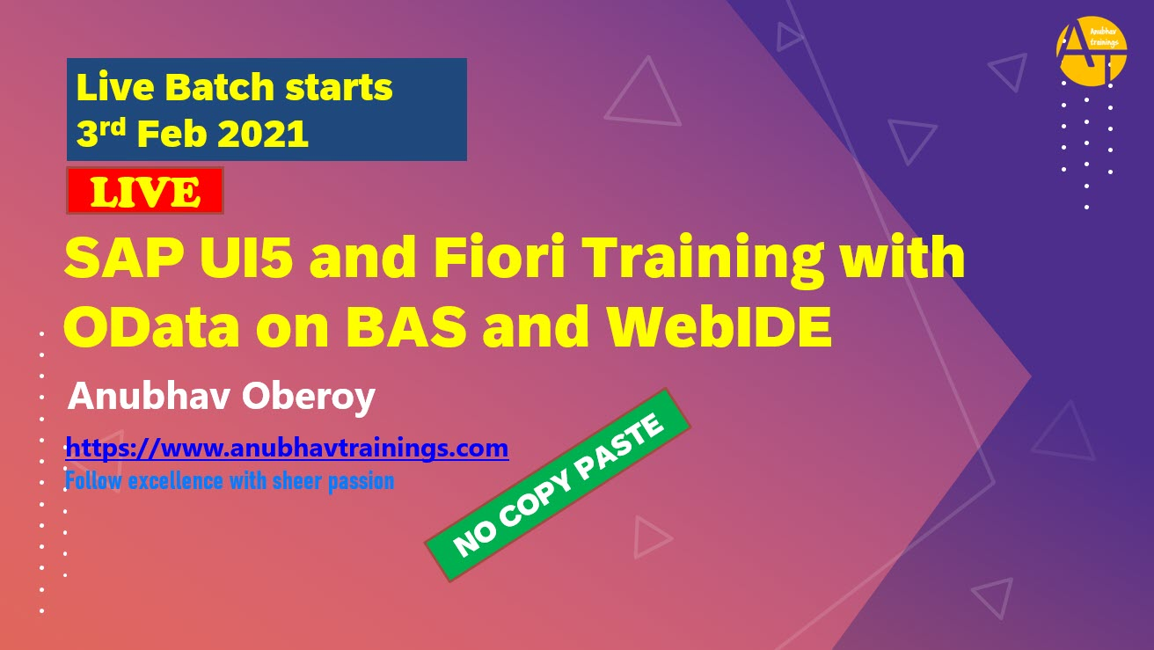

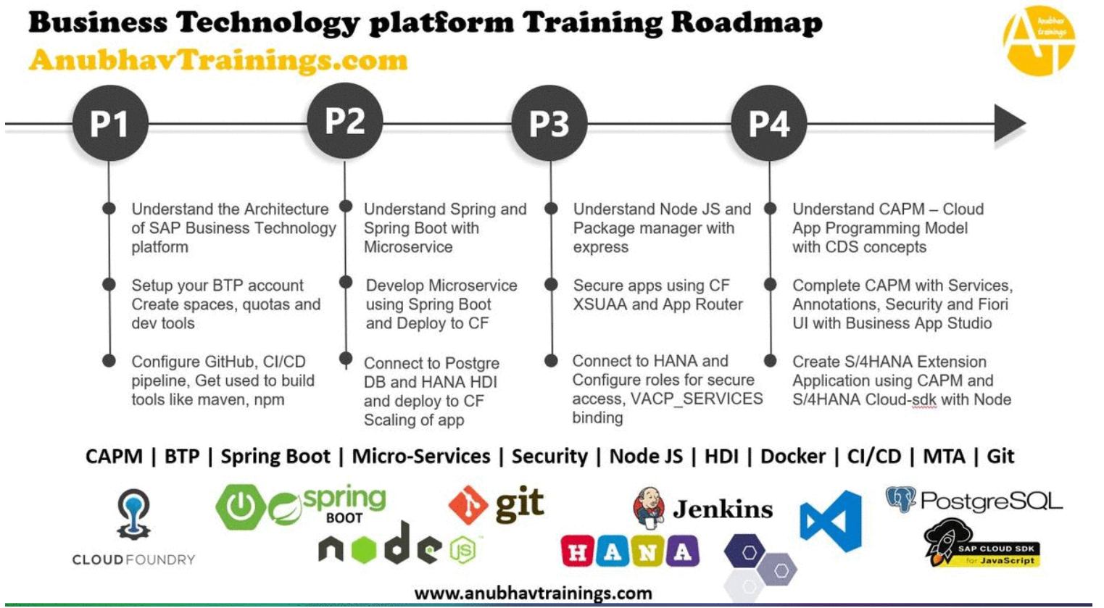
More from AnubhavTrainings.com

Slide 20






We’re committed to empower you to be
#FutureReady
through powerful training solutions.
We build the workforce of the future.
250+
Corporate Clients
30,000+
Learners Trained
25000+
Learners Placed
FREE WEBINARS
Sign up for free webinars with industry experts every fortnight!
Enroll Now!

Slide 21
FREE WEBINARS
Sign up for free webinars with industry experts every fortnight!
Contact us today!
www.anubhavtrainings.com

